Slide 1

Making ‘Feed Your Way’ Your Business Welcome everyone
Natalia Wroblewska Small Steps Big Changes
Notes:
Good afternoon everyone. My name is Natalia Wroblewska and I am a Senior Project Officer at SSBC and the lead for the Feed Your Way project. Before we start can I ask you all to switch your cameras and sound off please and can I ensure that everyone can hear me.
So thank you for attending our webinar ‘Making Feed Your Way your business which has been put together to increase awareness of our FYW campaign, our website and all the resources and assets that are available to support you when having conversations with the breastfeeding families that you work with.
I’m also very excited to be introducing the next phase of our campaign which will launch on the FYW website in August.
I’ll be discussing how FYW is not only your business but how we hope to make it everyone’s business so we’d love for you all to share information about the campaign and the supportive resources with your colleagues and the families that you work with.
The session will be interactive so I will be asking you questions as we go along for you to answer in the chat function and these questions will be added to the chat too.
So as we go through the slides I’d like you to have a think about any key points that you like about the campaign or potential areas for development?

Slide 2
Small Steps Big Changes
One of five A Better Start sites funded by the National Lottery Community Fund
£45 million investment (2015—2025)
'Children at the heart, parents leading the way, supported and guided by experts.'
Diet and nutrition is one of the key outcome areas.
Notes:
SSBC is one of five sites in the UK funded by the National Lottery Community Fund to commission and design community-centred early years services for local families and their children. Nottingham was awarded a 45 million investment over 10 years. The programme is due to end in March 2025 and we are currently in the legacy and sustainability stage of the programme, celebrating our achievements over 10 years and sourcing onward commissioning of our current projects. .
SSBC’s principle is ‘Children at the heart, parents leading the way, supported and guided by experts”, which reflects the programme’s commitment to coproduction with families.
Our services are designed to meet 4 main outcomes: improving children’s diet and nutrition being one of our key outcome areas.

Slide 3
Area | Initiation (first feed) | Continuation (6-8 weeks)
Nottingham | 72% | 48%
Aspley | 48% | 37%
Bulwell | 52% | 33%
Hyson Green & Arboretum | 63% | 60%
St Ann’s | 57% | 55%
Notes:
So what does the local context look like in terms of breastfeeding rates in Nottingham. Nottingham has lower breastfeeding rates than the national average.
The four SSBC target wards that SSBC predominantly work in have high levels of deprivation, and the percentage of babies breastfed at birth in these wards is lower than the Nottingham average. Hyson Green and Arboretum, a city ward with greater ethnic diversity, is an exception to this with relatively high breastfeeding continuation rates yet more needs to be done to support initiation rates across all areas.

Slide 4
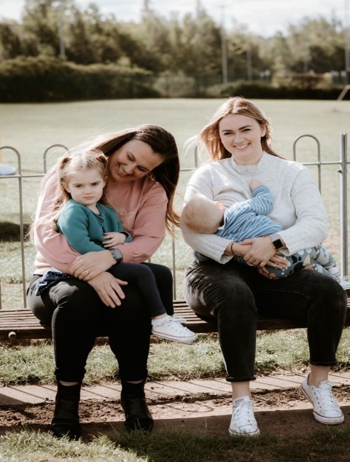
A Bespoke Breastfeeding Public Health Campaign for Nottingham City
Co-produced with local families, residents and workforce through the Big Nottingham Breastfeeding Survey and stakeholder/workforce surveys & interviews
Families need realistic breastfeeding education, particularly around breastfeeding challenges.
To adopt a whole family approach of support
A public health approach to improve community and societal attitudes and support around breastfeeding.
Notes:
Feed Your Way is a bespoke public health breastfeeding campaign commissioned by SSBC and delivered by a behaviour change marketing agency.
Feed Your Way was co-produced with local families, residents and the workforce. SSBC conducted extensive market research and spoke to thousands of families as part of the big Nottingham BF Survey. A survey was sent to a wide range of stakeholders and the early years workforce who have any role with infant feeding in Nottm with interviews to gather more in-depth information. So what did we find out?
Families told us they needed realistic breastfeeding education, to have honest and open conversations particularly around understanding the realities and challenges of breastfeeding and to have their support tailored based upon their own personal experiences.
Families wanted us to adopt a whole family approach by providing evidence-based information for friends and family members on how they could play a pivotal supporting role and to work together as a family unit.
SSBC also took a public health approach to improve community and societal attitudes and support around breastfeeding for example increasing support and normalising bf in public places supporting the ethos of making Nottingham a bf friendly city.

Slide 5
Main facilitators were:
Personal choice
Feeling of connectedness
Awareness of the challenges.
Led by Self-determination theory
Campaign priorities are:
Autonomy
Relatedness
Competence
Notes:
Instead of focusing on risk reduction health messaging, FYW encourages mothers to feel empowered to make personal choices to feed their way, however they want for as long as they want and shares real life stories about the realities and challenges of breastfeeding that families can connect with.
Our strategy throughout the FYW campaign is led by self-determination theory – we need 3 things to become intrinsically motivated to enact a behaviour. The FYW campaign prioritises:
Autonomy (breastfeeding is a personal choice) and using emotive case studies to evidence personal experiences of bf, relatedness (this is a collective issue and focusing on the relationships that support breastfeeding), and competence (every attempt is a success) taking it day by day rather than 6 week – 6 month targets over health-focused campaign messaging.
We wanted to focus on some of the ‘real moments’ that people often don’t see, to show that breastfeeding can fit around your life and change the way the topic of breastfeeding is approached.

Slide 6
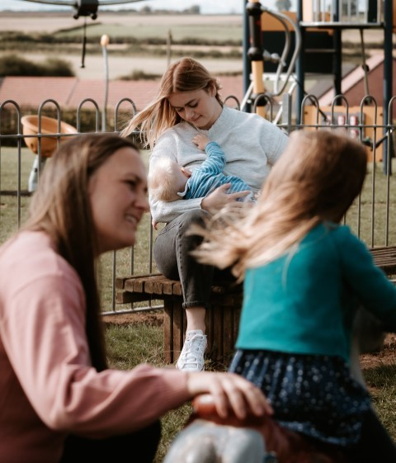
Evaluation – RE-AIM Framework
Internal mid-point evaluation by campaign provider
Focus on local families and residents
The campaign is well received, most people respond positively to it
External evaluator ‘s interim report
Focus on workforce
Campaign is viewed as inclusive, empowering, and evidence-based
25% of the workforce engage with the campaign
End point evaluation for workforce & families
www.smallstepsbigchanges.org.uk/knowledge-hub/learning-hub
Notes:
SSBC wanted to undertake a formative evaluation of Feed Your Way to understand how families and residents had seen, responded to, and interacted with the campaign, how the workforce had engaged with the campaign, and how the campaign can be further developed.
The RE-AIM framework was used as a starting point for the evaluation plan. The framework’s components of Reach, Efficacy, Adoption, Implementation and Maintenance are split across two evaluators.
The Feed Your Way behaviour change marketing agency undertook a mid-point evaluation of Reach and Efficacy and focused on local families and residents. The campaign and FYW messaging were well received and the majority of people responded positively to it.
SSBC has commissioned a specialist public sector advisor as the external evaluator for the Adoption, Implementation, and Maintenance components of the evaluation. They investigated how the campaign is being adopted and implemented by healthcare professionals, organisations and rolled out across the area considering the future legacy and onward commissioning of the campaign. The campaign was viewed as inclusive, empowering and evidence based, however, only 25% of the workforce were aware of the campaign and engaged with the resources. We now really need your support to really help embed the FYW campaign and support widespread adoption with your colleagues and the wider workforce.
How else do you feel that you can raise awareness of the campaign amongst your colleagues and with the families that you work with? I’ll give you up to a moment to answer (pause).
There will be an end point evaluation for the workforce & local residents and a culminative evaluation towards the end of the year that will inform future development of the campaign and its reach as it moves towards onward commissioning.

Slide 7
Planning in pregnancy
Partners/co-parents can play an active role
Breastfeeding can fit around your life and work
Breastfeeding/expressing through adversity (e.g. neonatal)
Breastfeeding is a civil issue (not a women’s issue)
Notes:
The campaign was launched in October 2022 and presents the real, lived experiences of six Nottinghamshire families. Their stories share a narrative of overcoming breastfeeding challenges.
The case studies were developed in response to breastfeeding experiences that matched the strategic priorities identified by families, stakeholders and the early years workforce. The case study themes included:
Planning for breastfeeding in pregnancy
The Importance of partners/co-parents and the active role that they can play to support bf
That breastfeeding can fit around your life and work
Breastfeeding/expressing through adversity (e.g. bf a neonate)
And finally, something that was inferred by many respondents, and that we hold as a strategic ambition - Breastfeeding is a civil issue (not just a women’s issue)
Diversity is reflected in ethnicity, gender, cross- and same-sex families and stages of parenthood, such as pregnancy and children of different ages.

Slide 8
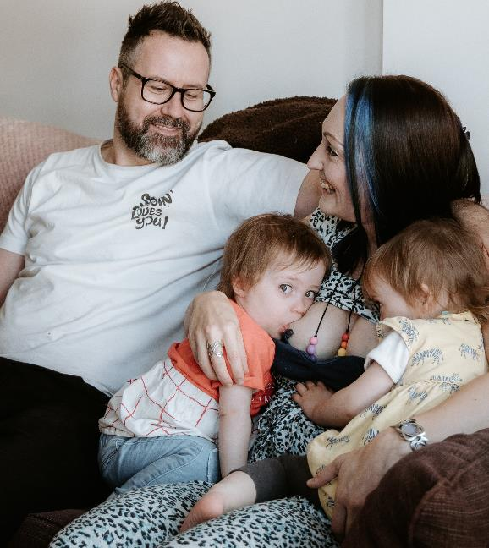

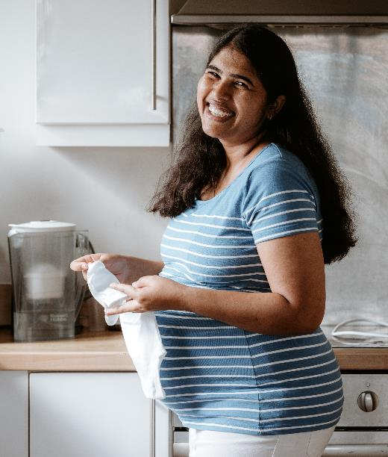
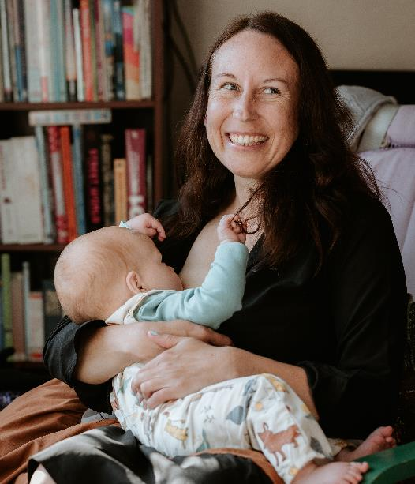
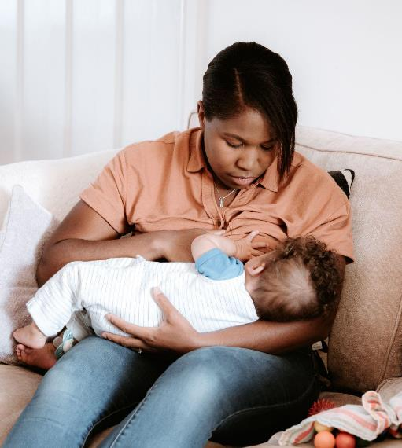
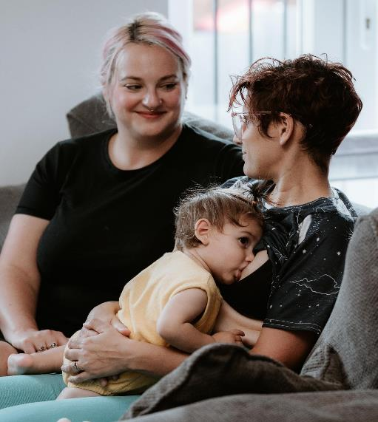

Our Case Studies
Your Stories - Feed Your Way
Notes:
The 6 families that we chose all had diverse breastfeeding and life experiences that we wanted other families to resonate with, who could talk to the various challenges and realities of breastfeeding and to offer advice from things they wished they knew to information they found along the way and to support other families on their bf journeys.
The case studies are the face of the campaign, a recognisable thread through all the campaign assets.
I’d now like to introduce you to our case studies for phase 1 of the campaign back in 2022.

Slide 9
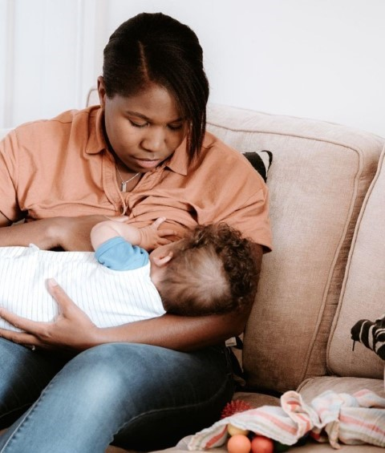
Meet Jessica
Jessica lives with her husband and two sons - Jackson, who was 4 at the time and Marley, who she breastfed.
Jessica had two very different breastfeeding experiences. Both came with their challenges. But Jessica was determined to breastfeed for as long as possible.
Her youngest son Marley was three months premature, which made establishing feeding a challenge. For the first few months, Jessica expressed milk so she could still give Marley breastmilk.
Jessica - Feed Your Way
Notes:
Go to main page.

Slide 10

Meet Vanitha
Vanitha lives in Hyson Green with her husband. At the time we spoke to her, she was 39 weeks pregnant with her second daughter.
Vanitha exclusively breastfed her first daughter for 3.5 years planned the same with her second daughter.
As she prepared for the arrival of her new baby, Vanitha shared some advice that she had received first time around.
Vanitha - Feed Your Way

Slide 11

Meet Clare
Clare is also a mum to two boys: Jack, who was 8, at the time and Oliver, who was 7 months old.
Having an 8-year-old whilst still breastfeeding meant Clare had to find ways to keep up the activities she enjoyed doing with her eldest whilst also feeding her youngest.
Clare often felt the pressure ‘to do it all’ with Jack. She managed to find a balance between staying busy and active all whilst enjoying those precious moments with Oliver.
Clare - Feed Your Way
Meet Clare

Slide 12
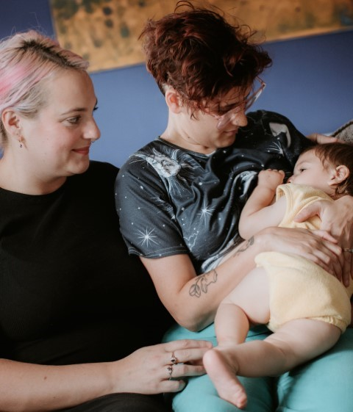
Meet Becca & Georgie
Becca and Georgie live in Beeston with their daughter, Minnie, and son, Persey. Georgie breastfed Minnie until she was 2.5 years old. Becca, spoke about how she returned to work, and continued feeding Persey.
Becca shared that having a supportive partner helped her to prepare.
Both found the first 6-8 weeks extremely challenging, which they had not necessarily expected. They wanted to tell parents that it can get better and easier.
Becca & Georgie - Feed Your Way

Slide 13
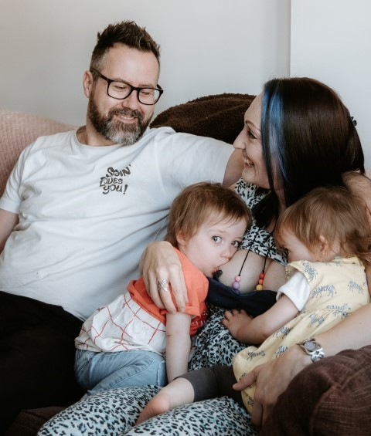
Meet Eleanor & Iain
Eleanor and Iain have three daughters: Chloe, and twin girls, Abigail and Naomi.
Eleanor experienced a few challenges but managed to feed her first until she was 19-months. At the time she was still tandem feeding her then 22-month-old twins.
Iain has been Eleanor’s biggest supporter and an integral part of her journey. He helped with breastfeeding research, cooking, household chores. Iain wanted to share that breastfeeding should involve many more people than just the breastfeeding parent and child.
Eleanor & Iain - Feed Your Way

Slide 14
Meet Robyn
Robyn is a mother of 2 and fed her then 13-month-old son, Oakley.
Robyn is a healthcare professional. She expresses at work. She tandem-fed both of her children when Oakley was born.
At first, Robyn was nervous about feeding her older daughter in public. She got a lot of support from her sister, who breastfed all 5 of her children.
Robyn - Feed Your Way
Notes:
If you would like to listen to each bf journey in more depth following the presentation and view the related resources please click onto the link on each page and it will take you straight to each video.

Slide 15
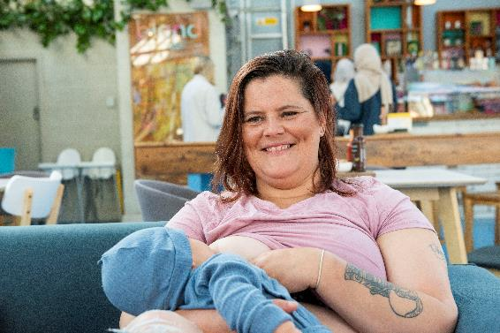
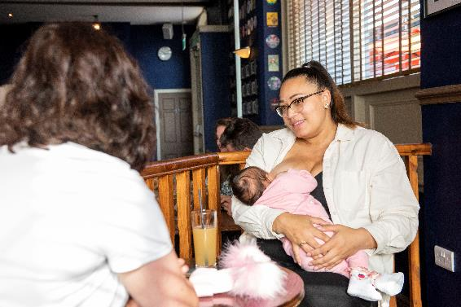
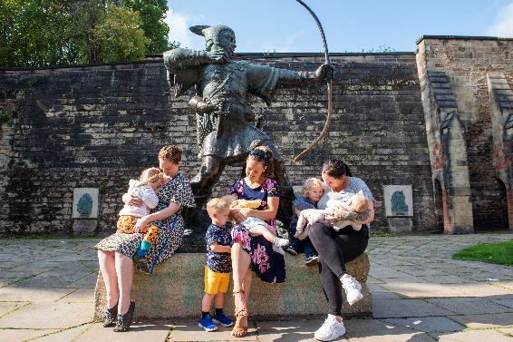
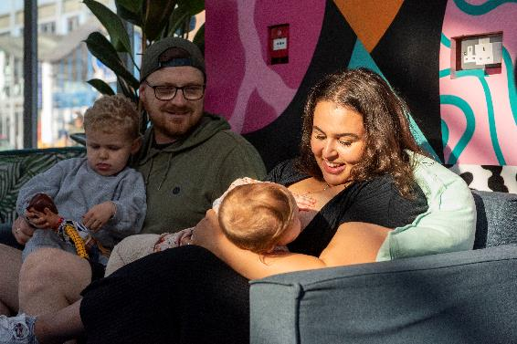
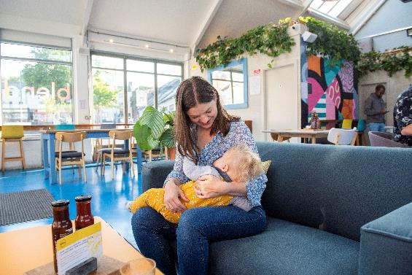
Citywide Photocall
Notes:
We didn’t want to leave out all of the other families who wanted to be involved- so we hosted a photoshoot in the city so that their photos could also be part of our FYW campaign and on our social media channels.

Slide 16
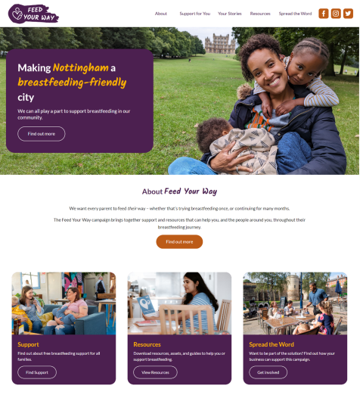
Website - feedyourway.co.uk
A hub of evidence-based resources that include:
Case studies - photography & videos
Signposting to local support services
Downloadable ‘print & keep’ breastfeeding support guides
Campaign asset bank
Notes:
We launched a bespoke website – the hub of our campaign, to support families to make the right feeding choices for them and their baby and support them on their breastfeeding journeys. If you’re not a bf parent, there’s also resources to help family members, friends and employees support a bf parent.
This includes:
Case studies (videos and photography), what support services are available for bf families, downloadable print and keep bf support guides, a campaign asset bank.
We’re also empowering the Nottingham community to make our city a breastfeeding-friendly place to live, work and study. If you’re interested in helping us achieve this goal there’s a link on the presentation to resources that explain how you can do more.

Slide 17
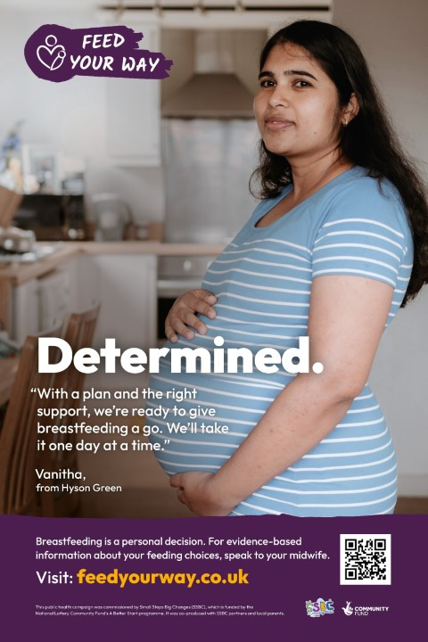

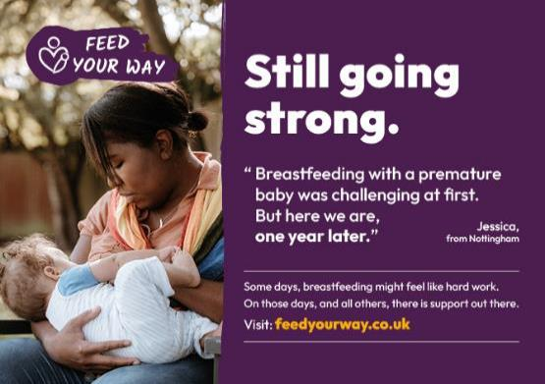
Posters & Printable Assets
Campaign Assets - Feed Your Way
Notes:
We have produced a suite of digital and printable assets for partners and stakeholders. This includes the FYW logo (as displayed on this slide), desktop background, pull up banners, A4 posters, postcards and business cards.
Our campaign assets are free to download from the website and the full suite of assets available to everyone is on our website.
We will be getting some more postcards, business cards and posters printed so please let me know if you would like any for your teams and to share with families.

Slide 18
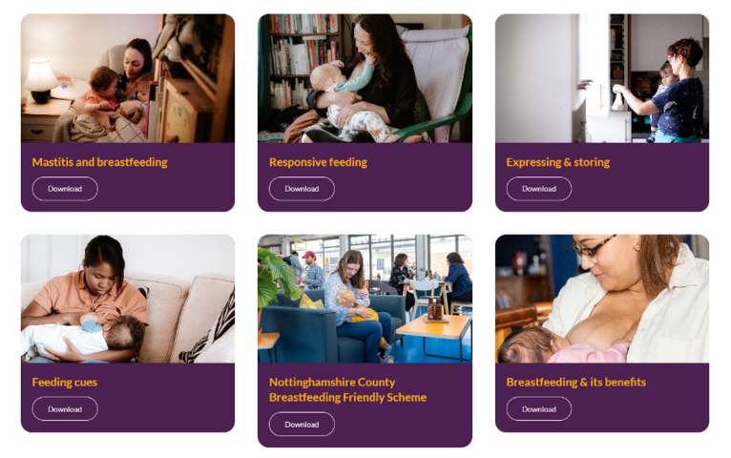
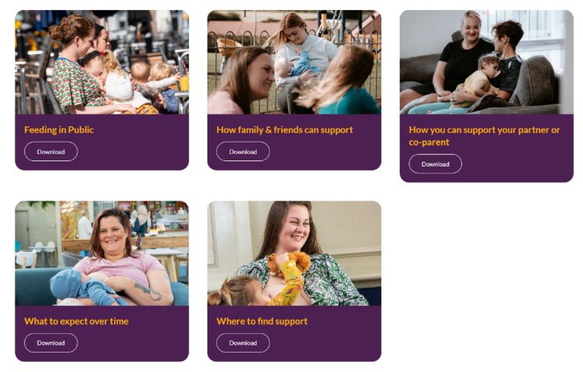
Downloadable Guides For breastfeeding people, partners/co-parents, employers, anyone who wants to learn about breastfeeding.
Resources - Feed Your Way
Notes:
We have a forum of downloadable guides to support you the workforce, bf people, partners, or anyone who wants to learn about bf. They provide a wealth of information to support you when you’re having conversations with families and to share with the families that you work with. These include topics such as ‘mastitis and bf’, responsive feeding, expressing and storing, feeding in public, how family and friends can support amongst other topics and are fully downloadable.
Could you let me know in the chat if you have used any of our resources or assets and what are your thoughts? I’ll give you a moment to answer (pause)

Slide 19


What we did next to inform phase 2 of Feed Your Way?
Findings from mid-point evaluation essential to inform future iterations of the campaign
Refer back to the Big Nottingham BF Survey
Further development of new case studies for phase 2 of the campaign
Desktop research to look for the evidence base for new case studies
Produce new campaign materials
Launch new case studies in August 2024
Notes:
SSBC were keen to produce more case studies based upon new themes. We looked at the mid-point evaluation and what you and local residents were saying and wanted future iterations of the campaign to look like. We also referred back to the Big Nottingham BF survey and pulled out key themes that had not yet been explored. This would inform further development of new case studies for phase 2 of the campaign. Once we had our themes we undertook extensive desktop research to enable us to look for the evidence base for each theme.
We are currently working with families and producing new campaign materials which include videos and photography which will be added to our existing FYW website shortly.
We plan to launch our new campaign materials the 2nd week of August – so please add these dates to your diaries.

Slide 20
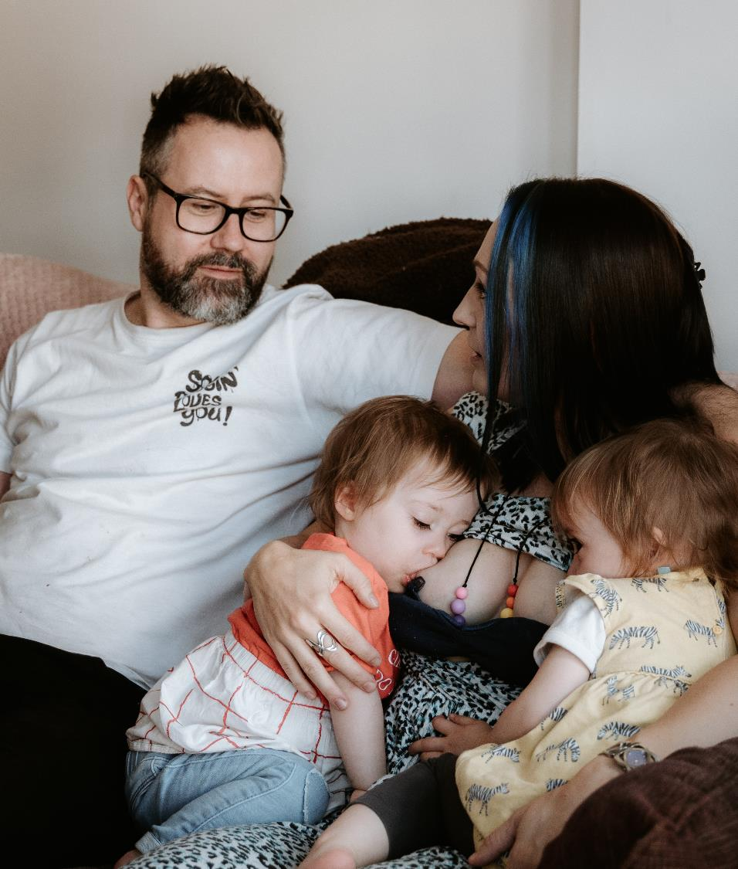
FYW Campaign Development
Themes – Phase 2
Additional case studies:
Neurodiversity
Young parent
Fathers
Grandparents
Ethnic diversity
Notes:
We are very excited to be expanding our campaign portfolio – mirroring and complementing phase one with more local stories and visual assets.
We have chosen 4 families to be the face of phase 2 of our FYW campaign. Our new case studies will each reflect a unique story and discuss the realities and challenges in relation to breastfeeding and neurodiversity, being a young parent and a fathers and grandparent’s perspective of being the supportive other.
The new case studies will be added to the SSBC website and content refreshed to reflect the new themes and to encourage engagement
Each family has their own experience of breastfeeding and diversity is represented in ethnicity, gender, age and representation of younger babies.
We will launch our new case studies on our FYW website the 2nd week of August.

Slide 21
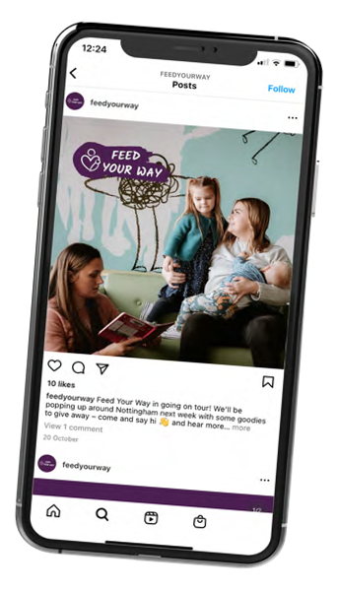
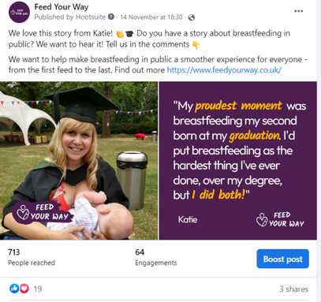
Social Media Facebook, Instagram & X (formerly Twitter)
Organic content - new stories added to our FYW website
Notes:
We also have an existing FYW facebook page and have recently launched our Instagram and X pages. Our facebook page features our case studies, families from our photoshoot, links to our resources, how we can all work towards making Nottingham more bf friendly and recent conferences that we presented the FYW campaign at.
There will be a coordinated period of digital advertising and social media activity commencing the first week of August to coincide with World BF week and we plan to launch the new case studies and refreshed website the 2nd week of August. You may also find us attending local events to promote the campaign.
Please let us know if you are attending or part of an event during August where we could promote our FYW campaign.

Slide 22
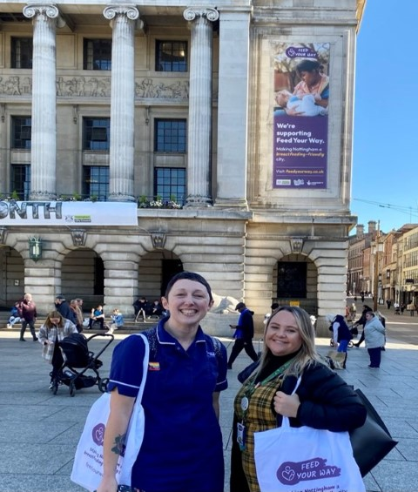
CALL TO ACTION: What you can do to support families and the campaign
Start using the resources from today
Share the campaign material with colleagues and families
Follow us on Facebook, X and Instagram
Add the FYW website into your favourites list
Add an August date to your diary for our FYW phase 2 launch of our new case studies
Support to raise awareness of the campaign?
Notes:
So what can you do to support families and the campaign? If you haven’t already done so please have a look at the FYW website and all the supportive information that is available to you. You can start using the resources from today.
Spread the word and share the campaign material with colleagues and families.
Follow us on Facebook, X or Instagram to receive regular updates and be the first to become aware of the launch of phase 2 of the campaign.
As an additional reminder add an August date to your diary as there will be regular updates during World BF week and so you don’t miss the launch of FYW phase 2.
And most important as discussed before we’d love for you to raise awareness of the campaign – amongst your colleagues, the wider workforce and the families that you work with.
I’d like you to add to the chat the key messages that you have taken away from today? I’ll give you a moment to answer (pause)

Slide 23
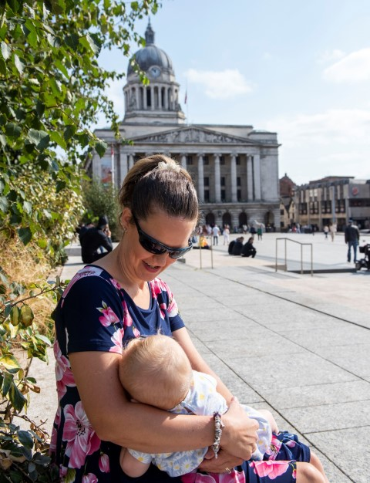
Next Steps Towards A
Breastfeeding-Friendly City
Breastfeeding friendly city – highlighting the value of supporting breastfeeding families as customers and employees.
Breastfeeding welcome scheme – families know where their needs will be met.
Onward commissioning – transition the campaign over to Nottingham City Council Public Health
Expanding assets portfolio – mirroring and complementing phase one with supportive resources to align with the new case studies and any gaps in information.
A workforce toolkit – how can they use campaign in work with families incorporating FYW messaging
Joint ownership and campaign for all – greater chance of impact and positive outcomes – system change
Notes:
We have a commitment to ensure that there is continued collaboration and commitment from across the partnership to integrate and embed bf friendly initiatives into practice, services, settings & businesses and ongoing work across the partnership to enable Nottingham and Nottinghamshire to become breastfeeding friendly.
This includes collaborations and working towards a breastfeeding welcome scheme to ensure that families know where their needs can be met.
SSBC will work with the council to transition the campaign towards onward commissioning to PH and embed learning into wider system developments, including:
Emerging ICS Strategy.
Growing the resources across the Integrated Care Partnership.
Supporting the Nottingham City Health and Wellbeing Strategy and Place Based Partnership.
We are looking to work with partners and parents to develop new resources that will align with the new case studies that we’re developing and gaps in information that you requested from mid-point evaluation.
The campaign resources will form a workforce toolkit and we hope to really embed FYW messaging into staff infant feeding sessions to support practitioners who work with families to support infant feeding discussions.
SSBC can support you to integrate the campaign into your practice, services and settings wherever you are.
This will enable a greater chance of impact and positive outcomes which results in systems change.

Slide 24



Thank you
Notes:
We will be collating all the questions from the chat and ensure they’re all answered.
If you have any further questions or would like to discuss anything please feel free to contact either myself or our Marketing and Communications Officer Ali Roberts. I hope you have found the webinar informative and thank you everyone for listening.

